Slide 1

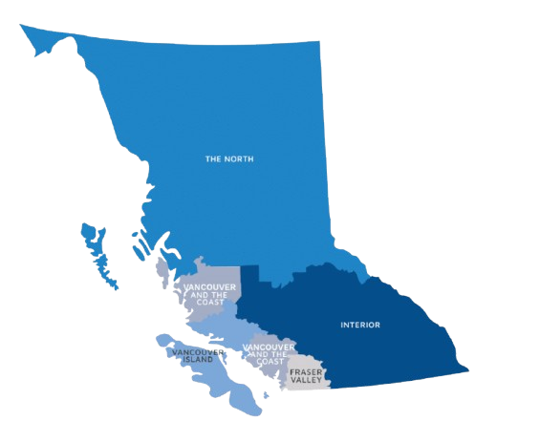

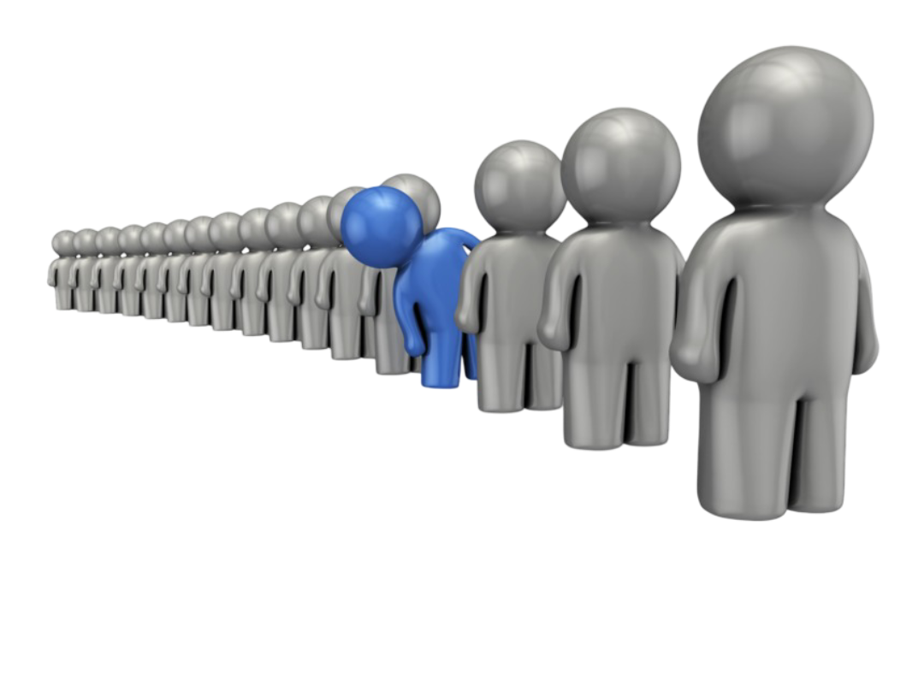

BC Surgical Wait Times
A Data-Driven Analysis of Surgical Wait Times
M2M Tech | DataTalent | Capstone Project – 2&3
Muthukannan Gomathisamynathan

Slide 2
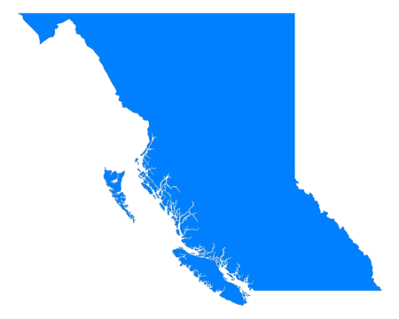
Large Image slide
Table of content
Recap of Capstone - 1
DataSet & Tools
Data Preparation
Insights
Modelling Approach
Model Performance
Validation
Insights
Conclusion & Future Plan
Notes:
© Copyright Showeet.com – Free PowerPoint Templates

Slide 3







Large Image slide
Recap of Capstone - 1
The Data is gathered from the BC Government website and Canada Open Government data
Tools:
VS Code
Jupyter
Numpy, Pandas
Bokeh
Scikit Learn
Data Preparation:
Combined the Population and Surgical waitlist datasets to single dataset, Cleaned it and Transformed it into a useable dataset suitable for ML model
Notes:
© Copyright Showeet.com – Free PowerPoint Templates

Slide 4

Large Image slide
Modelling Approach
Goal: Explain the "How" and "Why" of the model selection.
We chose Linear Regression for its high interpretability.
In healthcare policy, knowing why a prediction was made is more valuable than a "black box" prediction.
The Objective:
To predict the continuous variable WAITING_INT (Total Wait Days) based on geographic, demographic, and procedural features.
The Workflow:
Data Splitting: 80% Training (to teach the model) / 20% Testing (to evaluate performance on unseen data).
Target Variable: WAITING_INT.
Predictors: HEALTH_AUTHORITY, HOSPITAL_NAME, PROCEDURE_GROUP, Population, and COMPLETED_INT (Surgical Volume).
Notes:
© Copyright Showeet.com – Free PowerPoint Templates

Slide 5
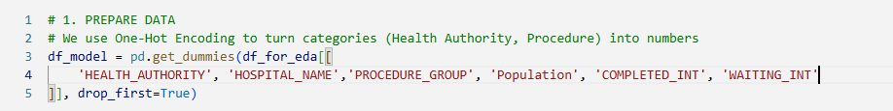

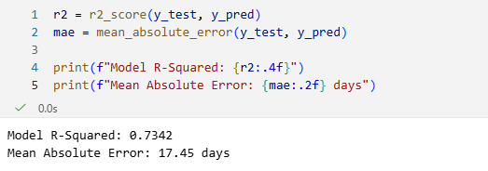
Large Image slide
Model Performance
In order to perfom the Math on strings, we used the One-Hot Encoding. i.e We transformed categorical variables into a series of binary (0 or 1) columns
To Prove that our model is reliable and accurate. We calculate the below Metrics
Key Metric:
R-Squared (R²) = 0.7342 The means, Our model explains 73.4% of the variance in surgical wait times.
For real-world healthcare data, this is a very high degree of predictability.
Notes:
© Copyright Showeet.com – Free PowerPoint Templates

Slide 6
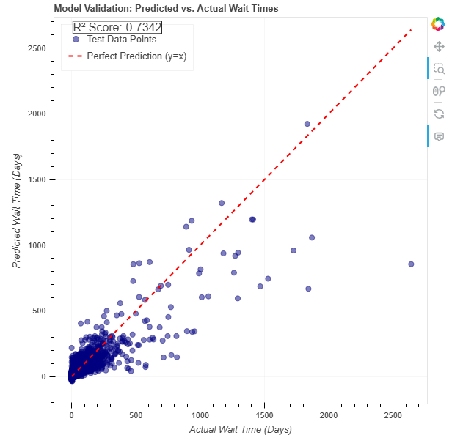
Large Image slide
Model Performance & Validation
Error Metric:
Mean Absolute Error (MAE) = 17.45 Days
The Meaning is, On average, the model’s predictions are within 17.5 days of the actual wait time.
A Predicted vs. Actual scatter plot is the standard way to visualize if our model’s R²
Here we expect that all our points would fall on a straight diagonal line (y = x). The closer the points are to that line, the more accurate our model is.
Notes:
© Copyright Showeet.com – Free PowerPoint Templates

Slide 7

Large Image slide
Insights
Key Drivers of Delay (The Coefficients) – The Smoking Gun (What’s causing the Actual Delay)
Top Positive Coefficients (Drivers of Delay):
Knee Replacement: 126.5 Days
Cataract Surgery: 91.8 Days
Hip Replacement: 54.4 Days
The "Takeaway" Insight:
The model proves that the Type of Procedure is a far more powerful predictor of wait time than the City or Population Size.
This confirms that the backlog is a capacity/specialty issue, not just a "too many people" issue.
Notes:
© Copyright Showeet.com – Free PowerPoint Templates

Slide 8

Large Image slide
Conclusion & Future Plan
When we moved into the predictive phase, we didn't just want a number; we wanted an explanation
Location, Population, and procedure type are the correct variables to be watching
Add More data like No of Surgeons and Hospital Staffs, Infrastructure and Social Factors
Notes:
© Copyright Showeet.com – Free PowerPoint Templates

Slide 9




THANK YOU
Muthukannan Gomathisamynathan
https://linkedin.com/gmuthukannan
https://github.com/gmuthukannan

